Slide 1
Graph Neural Networks
Lectured by Shangsong Liang
Notes:
Some slides are from Thomas Kipf, University of Amsterdam
https://www.cs.ubc.ca/~lsigal/teaching.html
Some slides are from https://disi.unitn.it/~passerini/teaching/2021-2022/AdvancedTopicsInMachineLearning/slides/GNN/talk.pdf

Slide 2
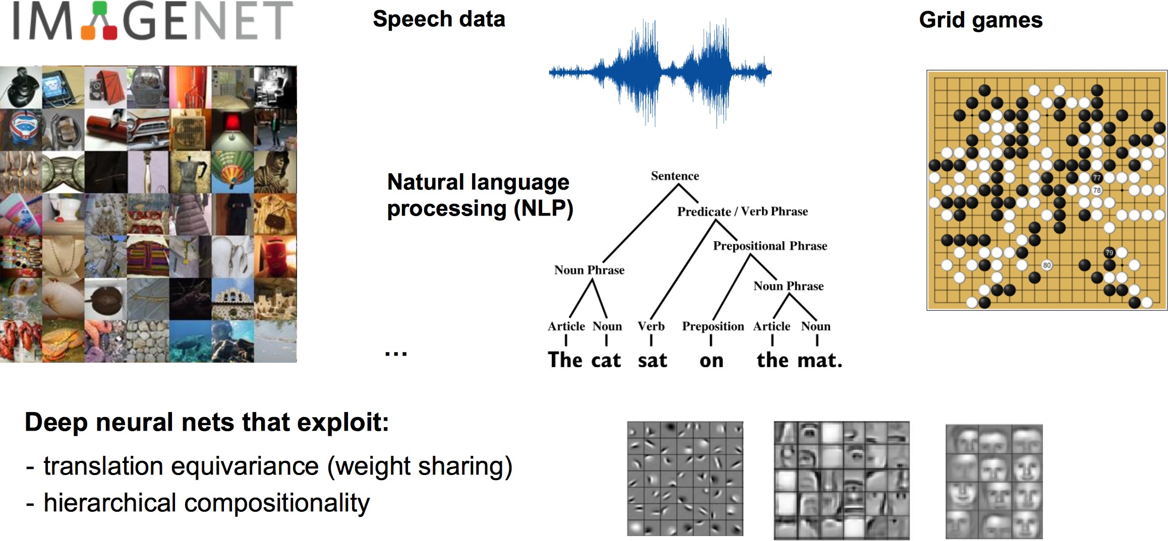
Traditional Neural Networks

Slide 3
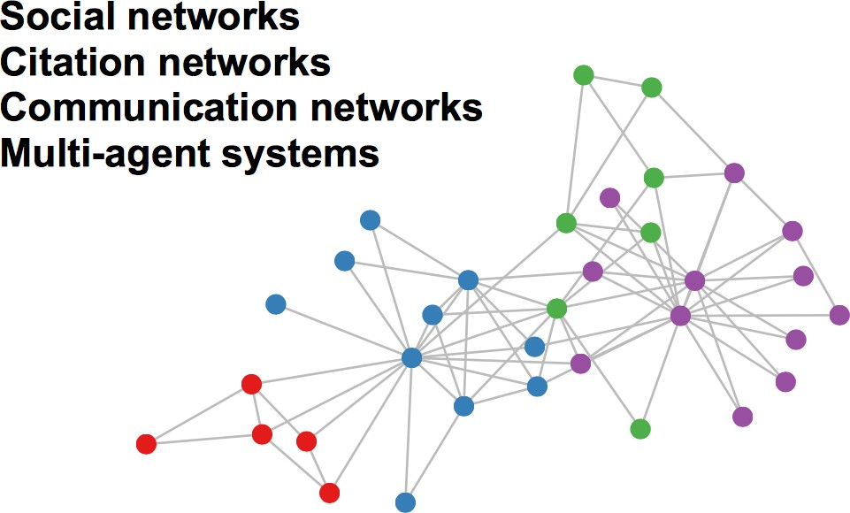
Graph-structured Data
A lot of real-world data does not “live” on grids

Slide 4
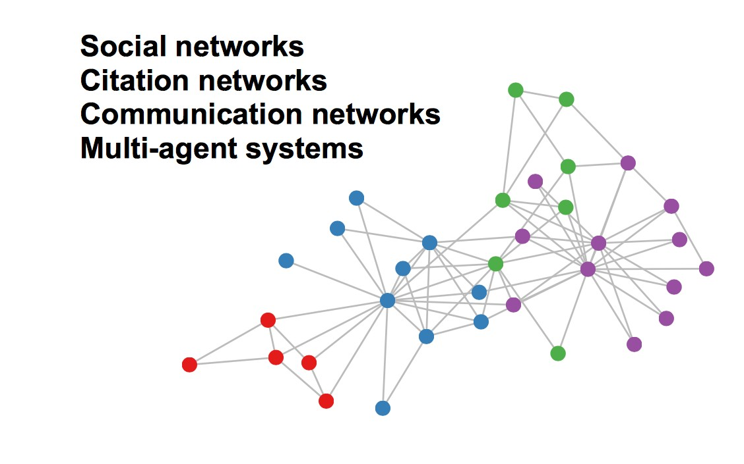
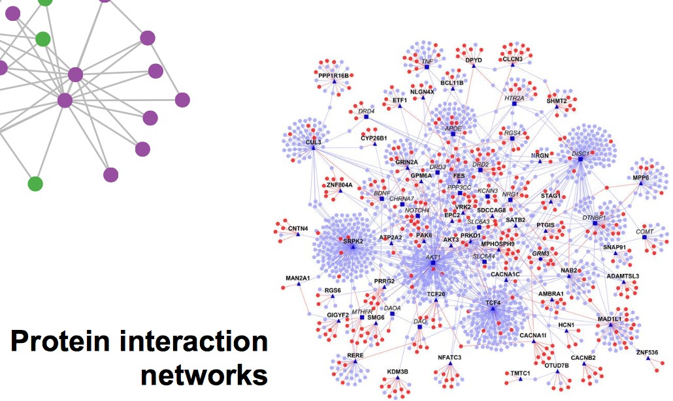
Graph-structured Data
A lot of real-world data does not “live” on grids

Slide 5
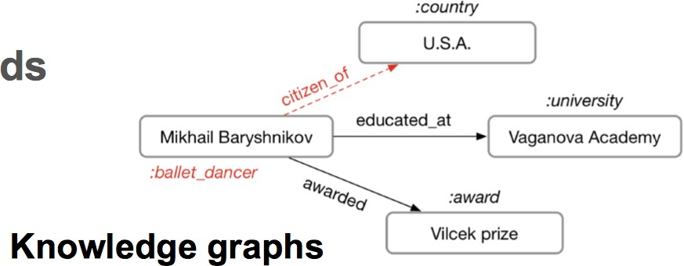
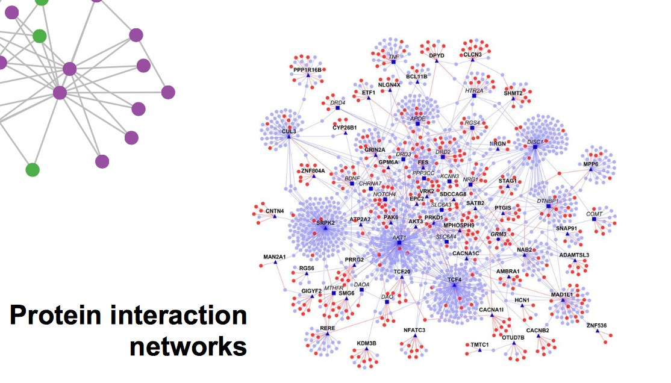
Graph-structured Data
A lot of real-world data does not “live” on grids

Slide 6
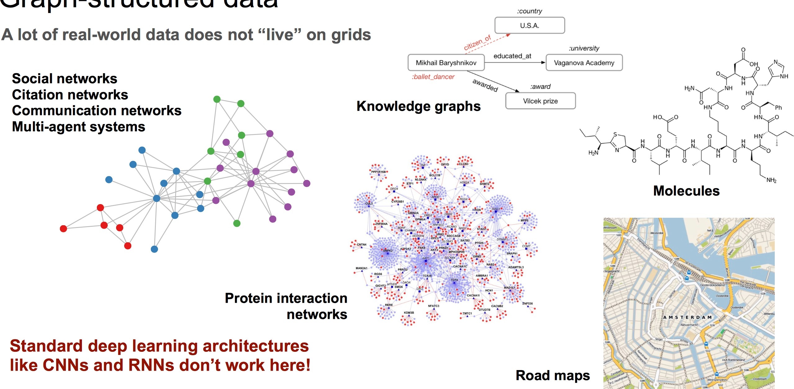
Graph-structured Data
A lot of real-world data does not “live” on grids

Slide 7
Graph-structured Data
A lot of real-world data does not “live” on grids
Standard CNN and RNN architectures don’t work on this data

Slide 8
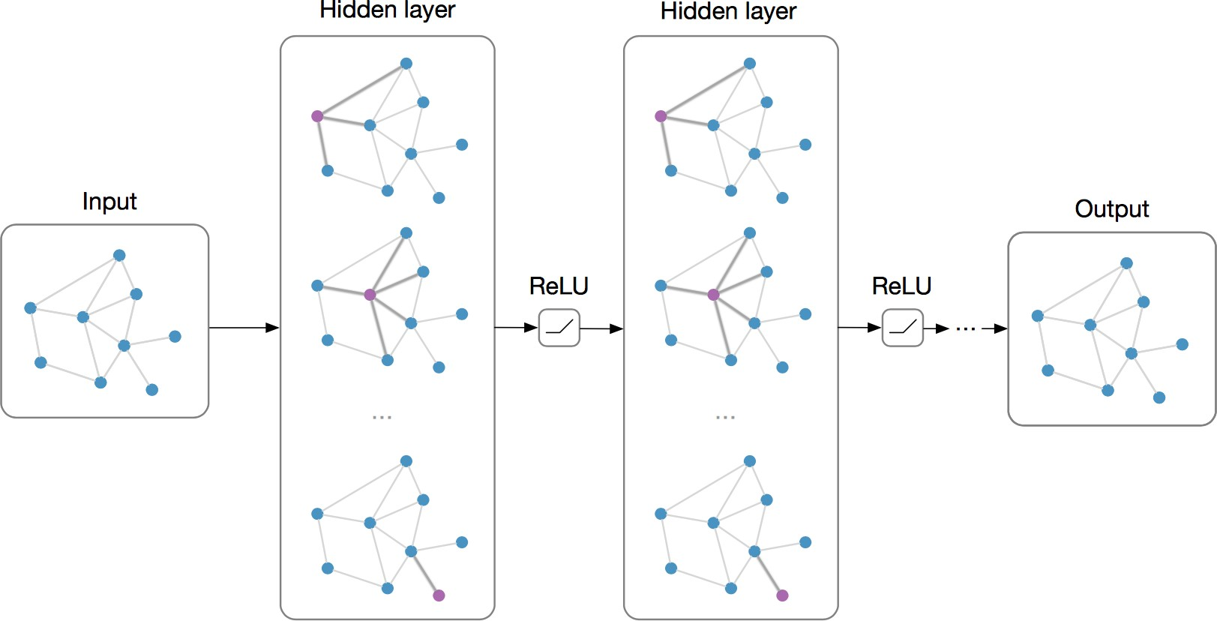
Graph Neural Networks (GNNs)
Main Idea: Pass massages between pairs of nodes and agglomerate
Alternative Interpretation: Pass massages between nodes to refine node (and possibly edge) representations

Slide 9
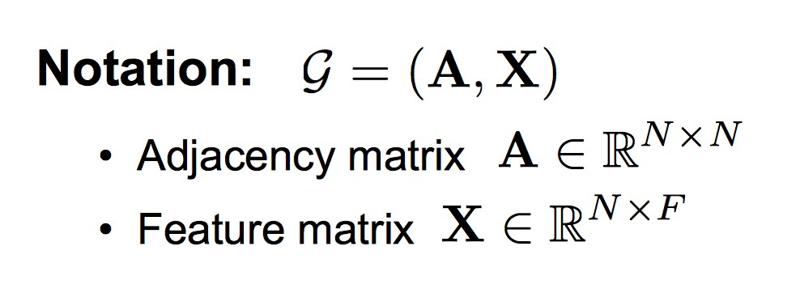
Graph Neural Networks (GNNs)
Main Idea: Pass massages between pairs of nodes and agglomerate
Alternative Interpretation: Pass massages between nodes to refine node (and possibly edge) representations

Slide 10
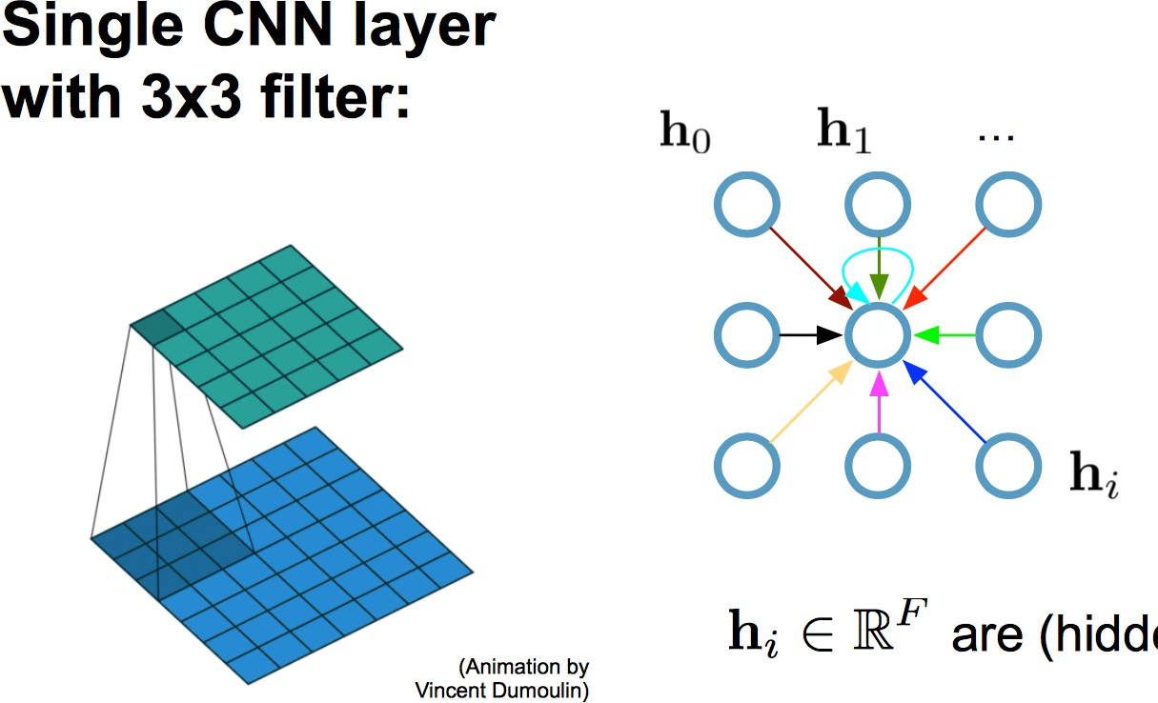
Recap: Convolutional Neural Networks (CNNs) on Grids

Slide 11
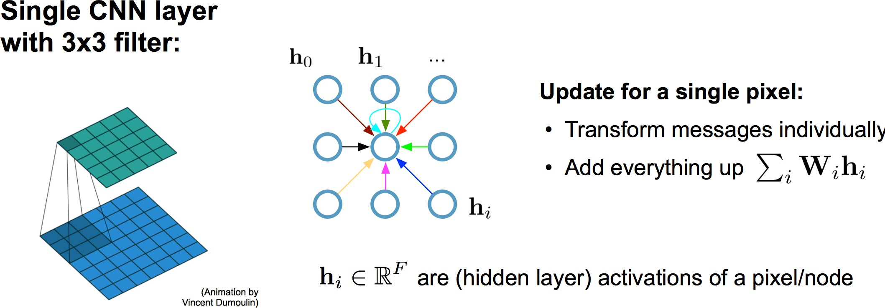
Recap: Convolutional Neural Networks (CNNs) on Grids

Slide 12
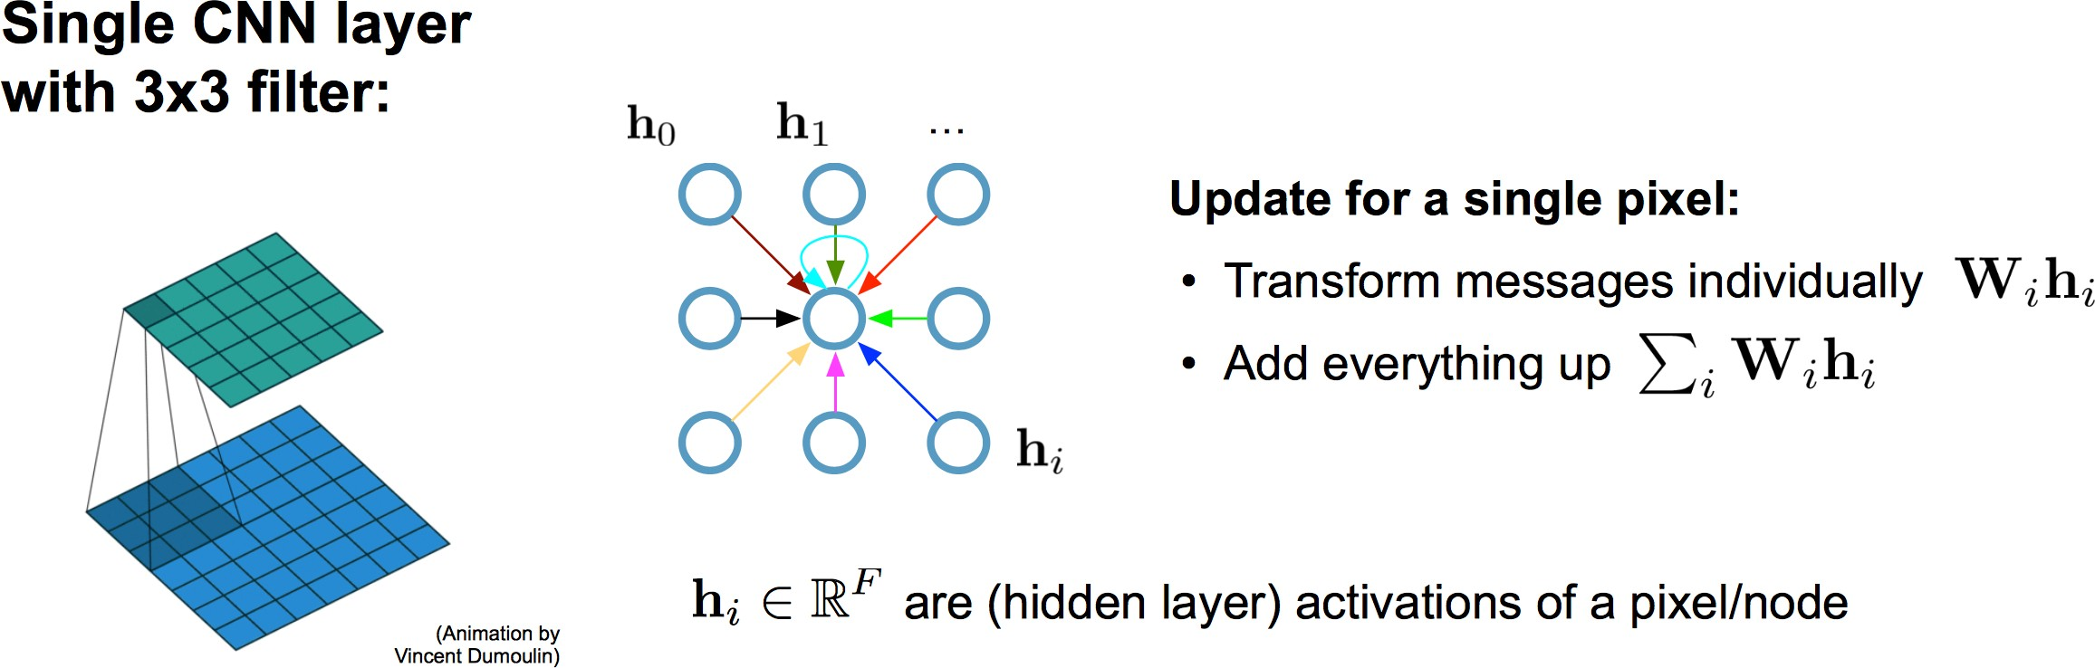
Recap: Convolutional Neural Networks (CNNs) on Grids

Slide 13
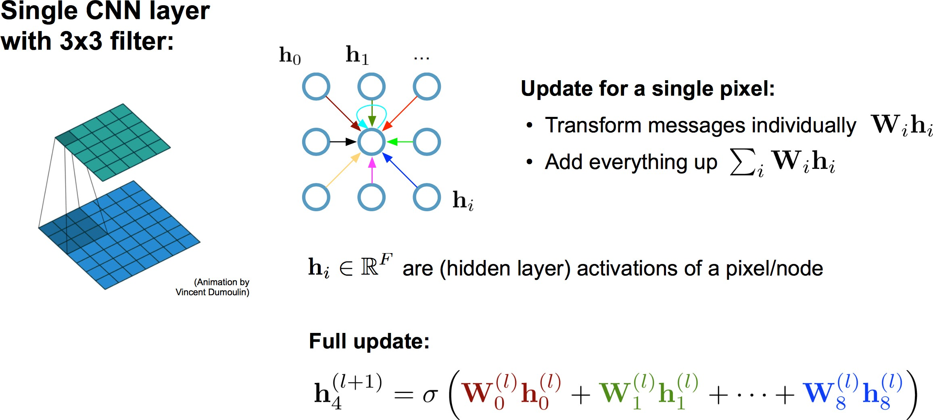
Recap: Convolutional Neural Networks (CNNs) on Grids

Slide 14
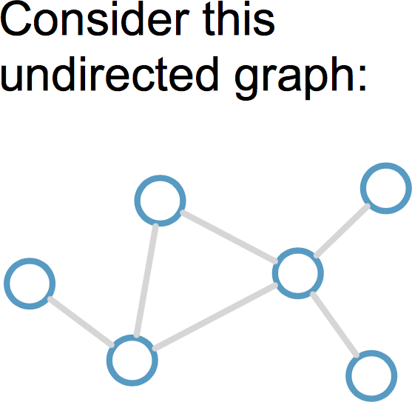
Graph Convolutional Networks (GCNs)
Kipf & Welling (ICLR 2017), related previous works by Duvenaud et al. (NIPS 2015) and Li et al. (ICLR 2016)

Slide 15
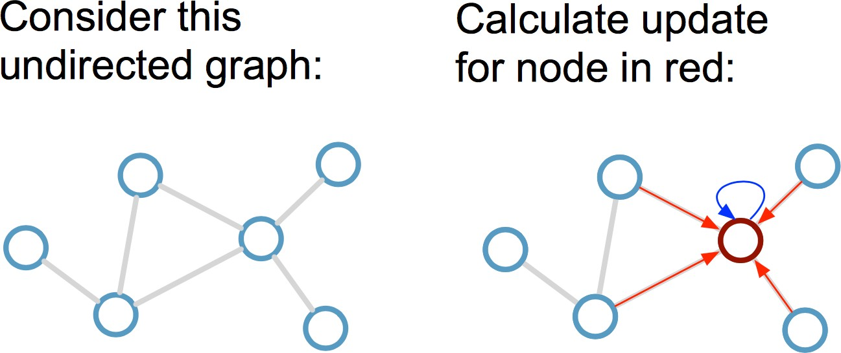
Graph Convolutional Networks (GCNs)
Kipf & Welling (ICLR 2017), related previous works by Duvenaud et al. (NIPS 2015) and Li et al. (ICLR 2016)

Slide 16
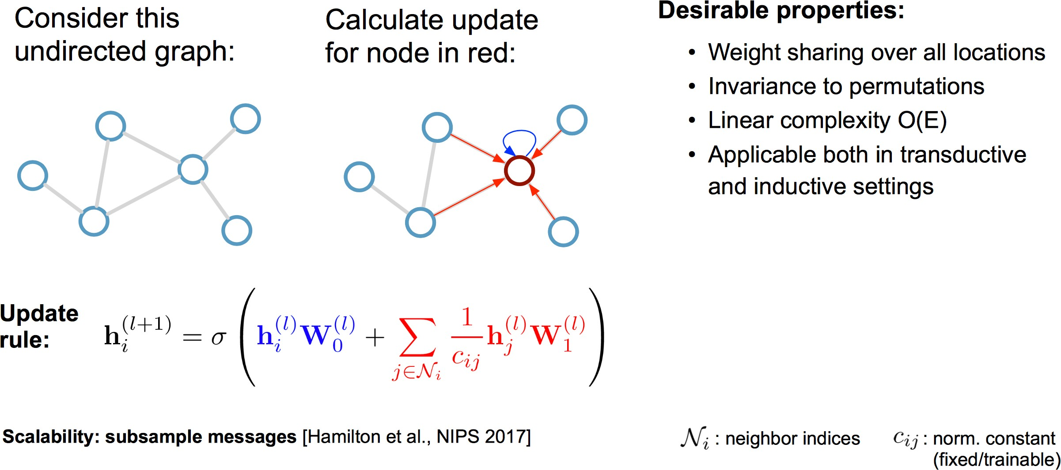
Graph Convolutional Networks (GCNs)
Kipf & Welling (ICLR 2017), related previous works by Duvenaud et al. (NIPS 2015) and Li et al. (ICLR 2016)

Slide 17
Graph Convolutional Networks (GCNs)
Kipf & Welling (ICLR 2017), related previous works by Duvenaud et al. (NIPS 2015) and Li et al. (ICLR 2016)

Slide 18
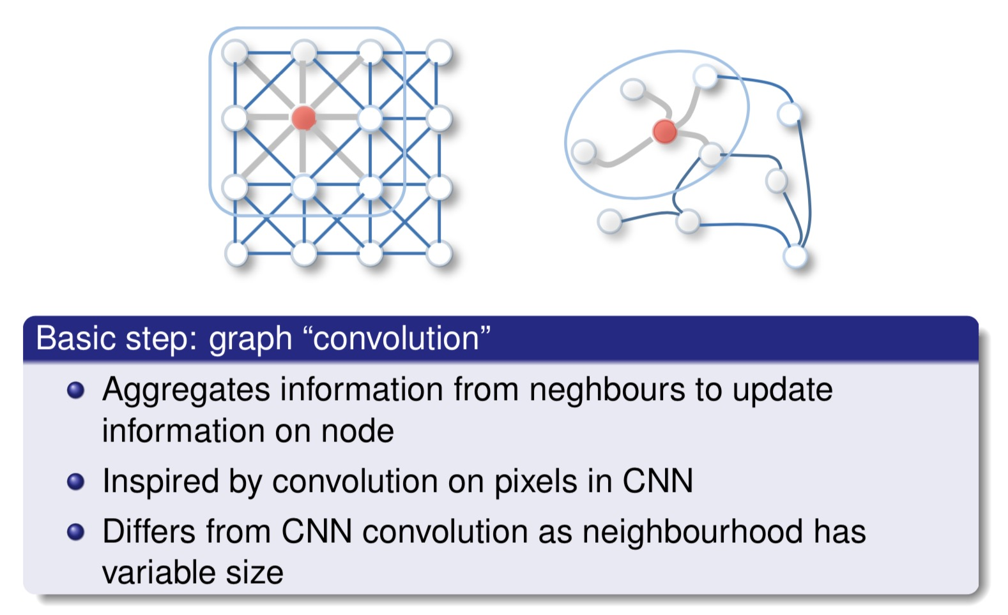
Graph Convolutional Networks (GCNs)

Slide 19
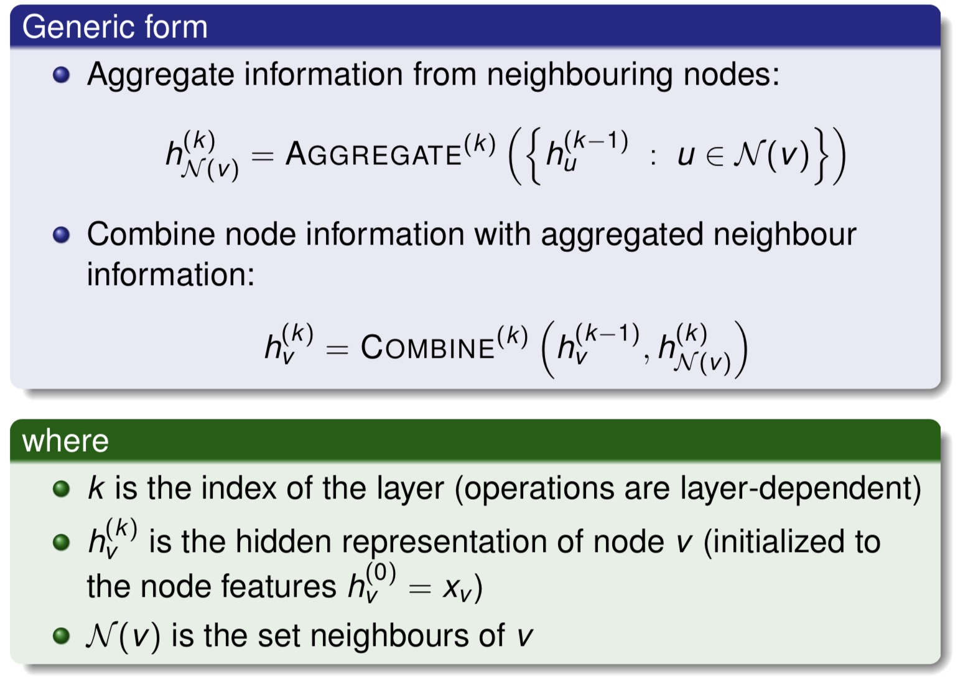
Graph Convolutional Networks (GCNs)

Slide 20
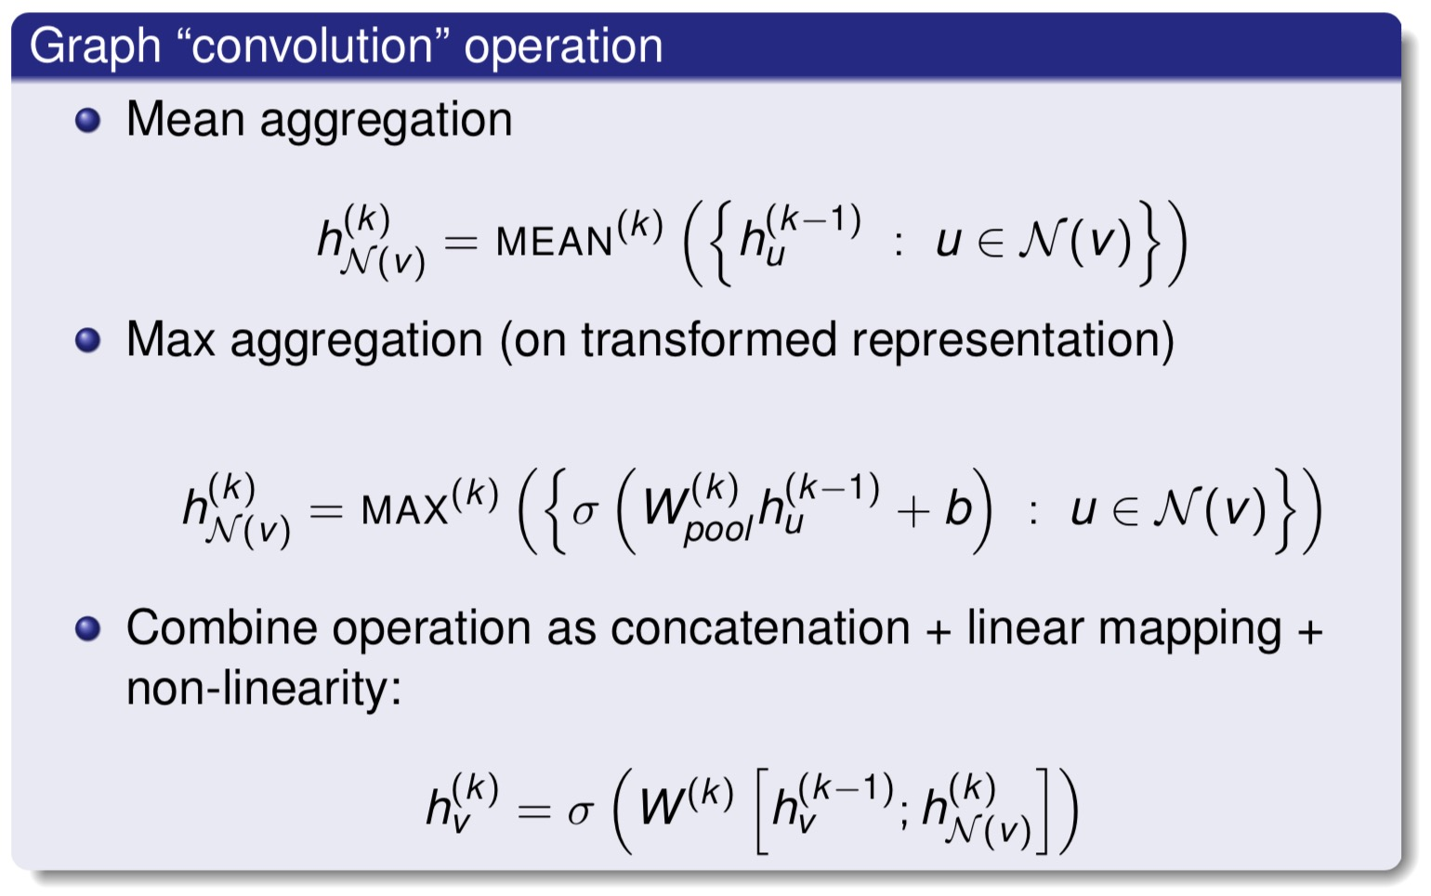
Graph Convolutional Networks (GCNs)

Slide 21
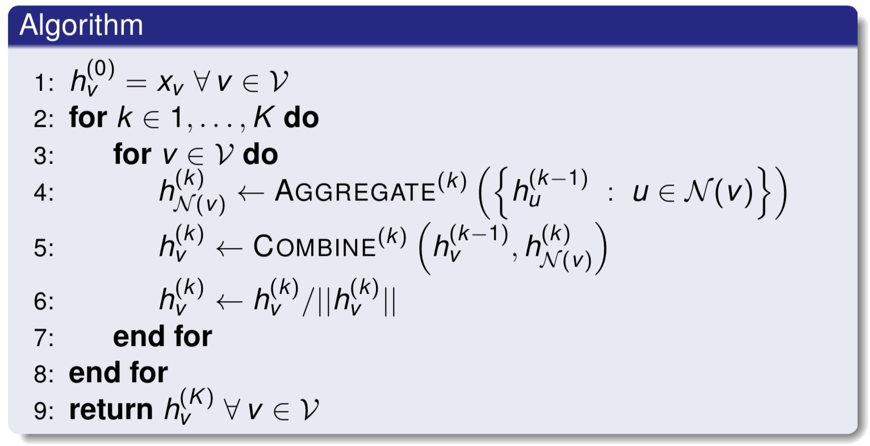
Graph Convolutional Networks (GCNs)

Slide 22
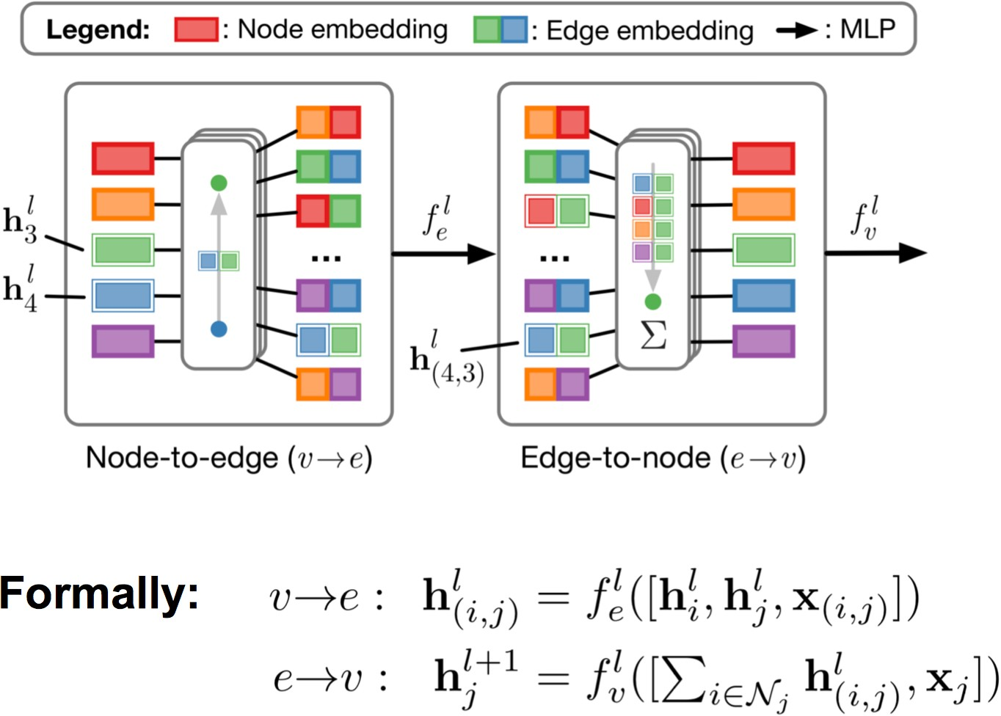
GNNs with Edge Embeddings
Battaglia et al. (NIPS 2016), Gilmer et al. (ICML 2017), Kipf et al. (ICML 2018)

Slide 23
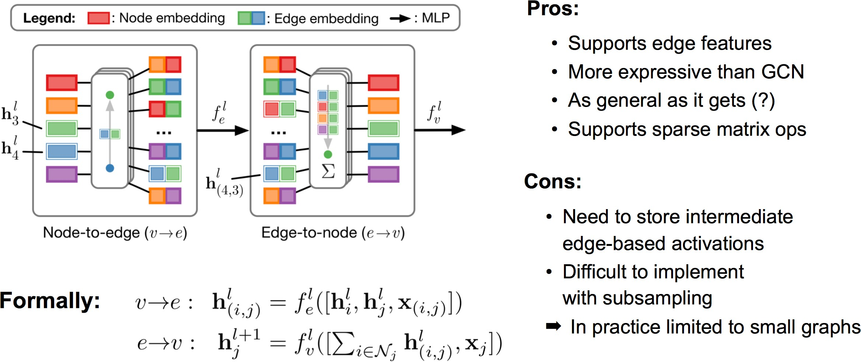
GNNs with Edge Embeddings
Battaglia et al. (NIPS 2016), Gilmer et al. (ICML 2017), Kipf et al. (ICML 2018)

Slide 24
GNNs with Edge Embeddings
Battaglia et al. (NIPS 2016), Gilmer et al. (ICML 2017), Kipf et al. (ICML 2018)

Slide 25
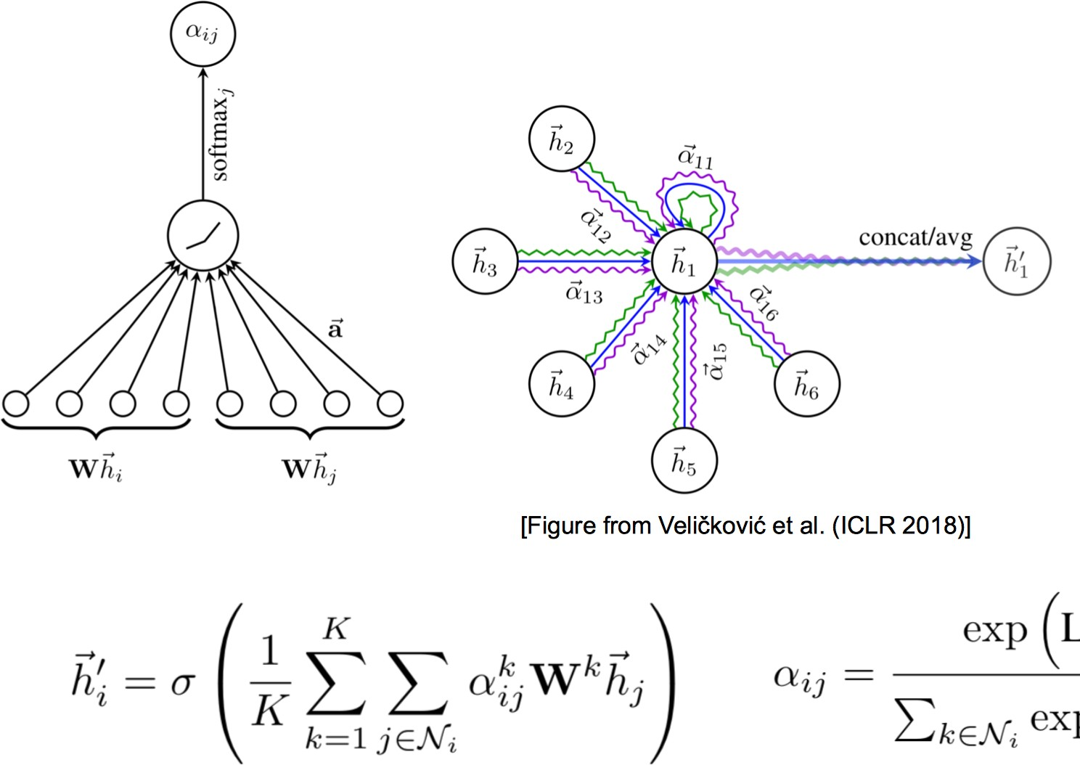
Graph Neural Networks (GNNs) with Attention
Monti et al. (CVPR 2017), Hoshen (NIPS 2017), Veličković et al. (ICLR 2018)

Slide 26
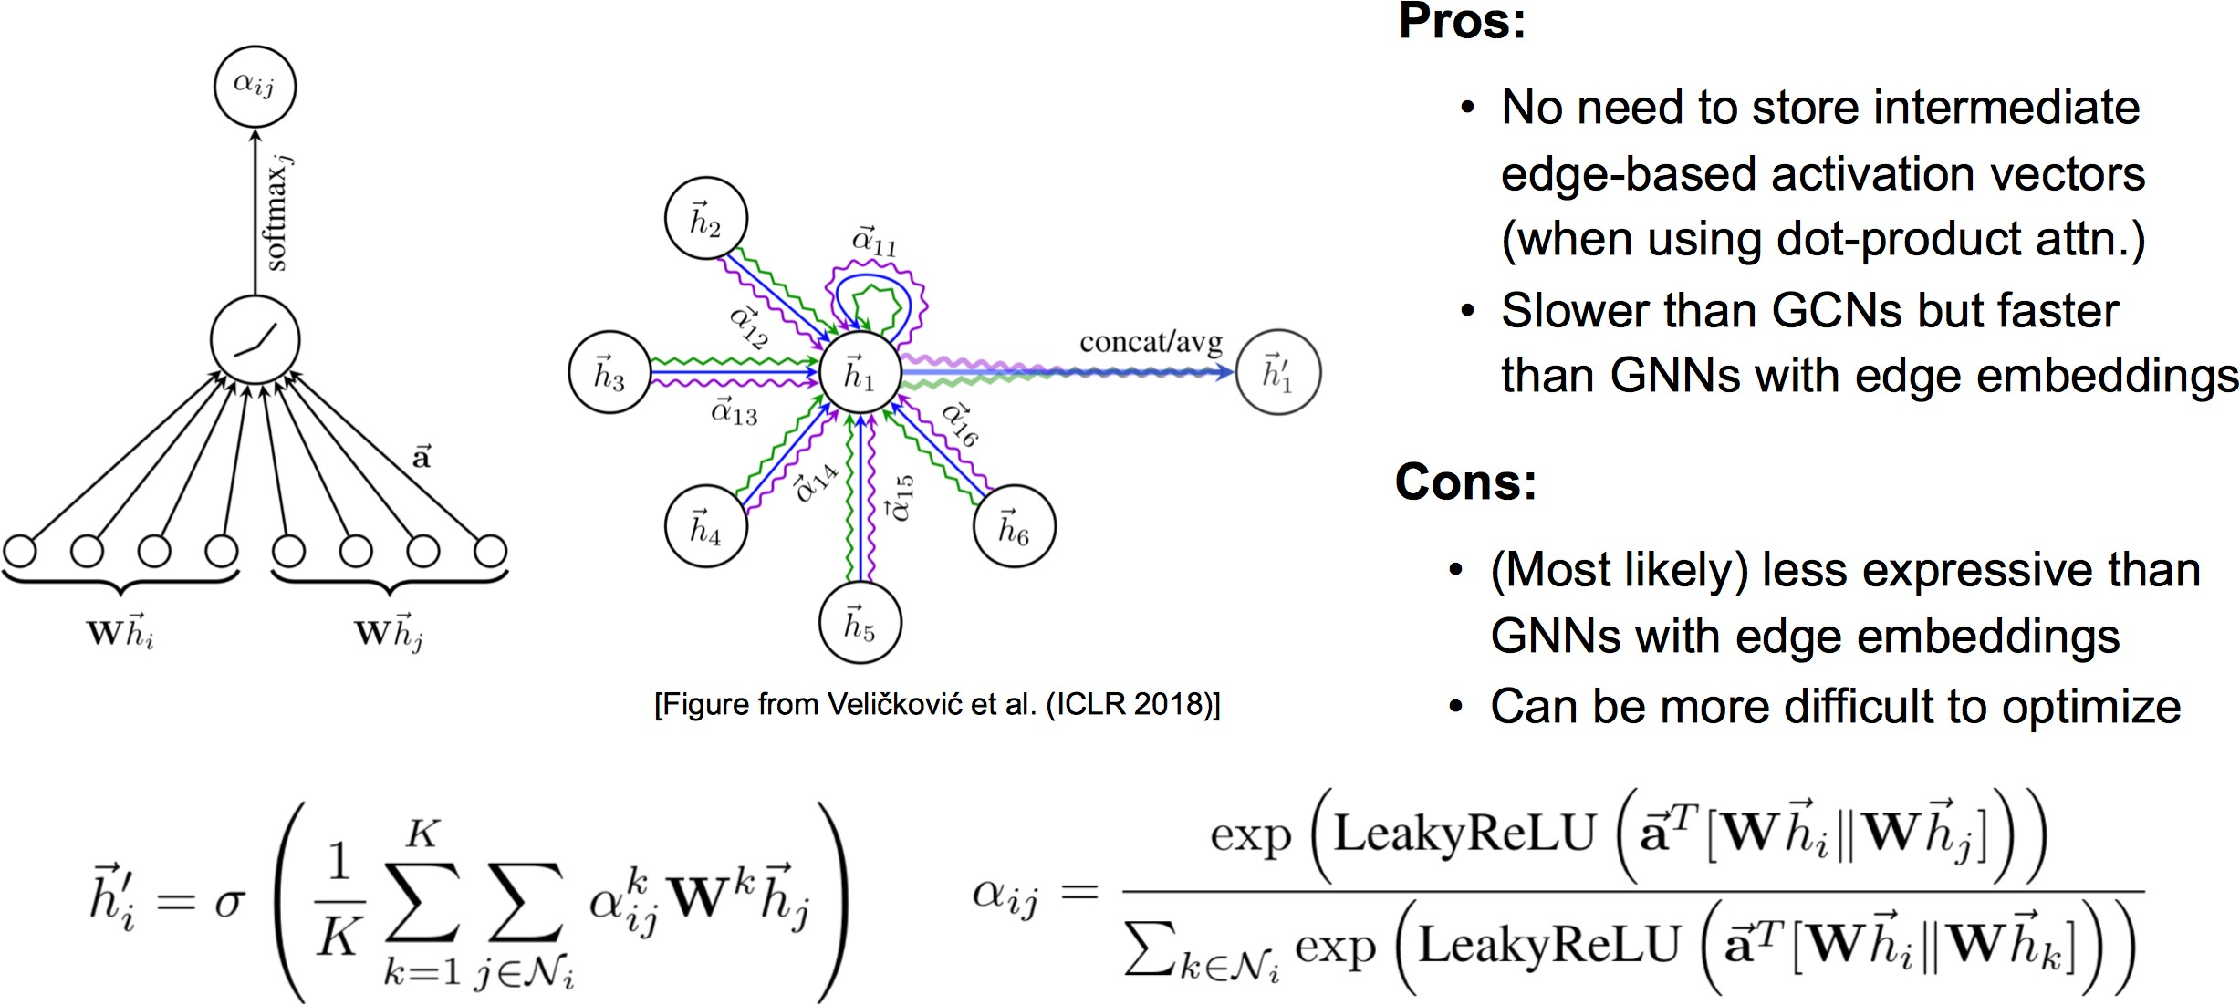
Graph Neural Networks (GNNs) with Attention
Monti et al. (CVPR 2017), Hoshen (NIPS 2017), Veličković et al. (ICLR 2018)

Slide 27
Graph Neural Networks (GNNs) with Attention
Monti et al. (CVPR 2017), Hoshen (NIPS 2017), Veličković et al. (ICLR 2018)

Slide 28
Graph Neural Networks (GNNs) with Attention
Monti et al. (CVPR 2017), Hoshen (NIPS 2017), Veličković et al. (ICLR 2018)

Slide 29
GNN for Graph Classification
Basic approaches
Apply final aggregation (READOUT) to combine all nodes in a single representation (mean, sum).
Introduce a “virtual node” connected to all nodes in the graph
Problems
No hierarchical structure is learned.
Lack of “pooling” operation which is effective in CNNs to learn complex pattern.
Graph Neural Networks

Slide 30
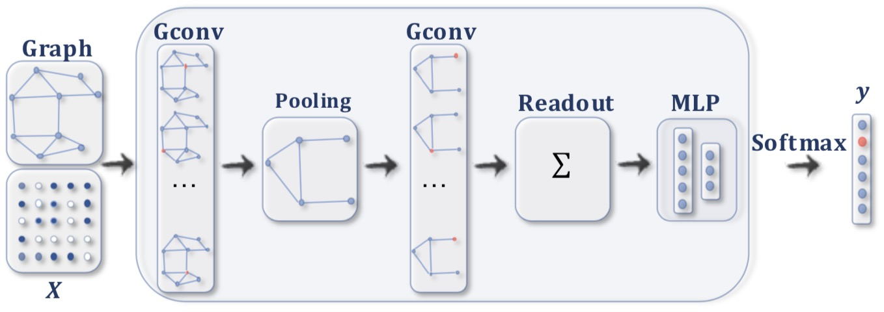
GNN for Graph Classification
𝑋
Features
Alternate convolutional and pooling layers as in CNN. Progressively reduce number of nodes.
Pool all nodes in last layer into a single representation.
Problem
How to decide which nodes to pool together
Image from Wu et al., 2019
Graph Neural Networks

Slide 31


GNN for Graph Classification
Original network
Pooled network at level 1
Pooled network at level 2
Pooled network at level 3
Graph classification
Idea
Use standard GNN module to obtain embedding of nodes
Perform graph pooling using a differentiable soft cluster assignment module
Repeat the process for K layers Aggregate in single cluster in the last layer Use final representation to classify graph
Image from Ying et al., 2018
Graph Neural Networks

Slide 32


GNN for Graph Classification
Original network
Pooled network Pooled network Pooled network at level 1 at level 2 at level 3
Graph classification
Components
Layerwise soft cluster assignment matrix: S^{(k )} ∈ IR^{nk ×nk +1} Layerwise input embedding matrix: Z ^{(k )} ∈ IR^{nk ×d} Layerwise soft adjacency matrix: A^{(k +1)}
Layerwise output embedding matrix: X ^{(k +1)} ∈ IR^{nk +1×d}
Image from Ying et al., 2018
Graph Neural Networks

Slide 33
GNN for Graph Classification
Compute A^{(k +1)}, X ^{(k +1)} given S^{(k )}, Z ^{(k )}
Computer A^{(k +1)} based on connectivity strength between nodes in cluster
_{A}(k +1) _{= S}(k )^{T} _{A}(k )_{S}(k )
Compute X ^{(k +1)} as weighted combination of cluster (soft) members
_{X} (k +1) _{= S}(k )^{T} _{Z} (k )
Graph Neural Networks

Slide 34
GNN for Graph Classification
Compute S^{(k )}, Z ^{(k )} given A^{(k )}, X ^{(k )}
Computer Z ^{(k )} using a standard GNN module
_{Z} (k ) _{= GNN}embed _{(A}(k )_{, X} (k )₎
k
Computer S^{(k )} using a second standard GNN module followed by a per-row sofmax
(k ) pool (k ) (k )
S = SOFTMAX GNN (A , X )
k
Graph Neural Networks

Slide 35
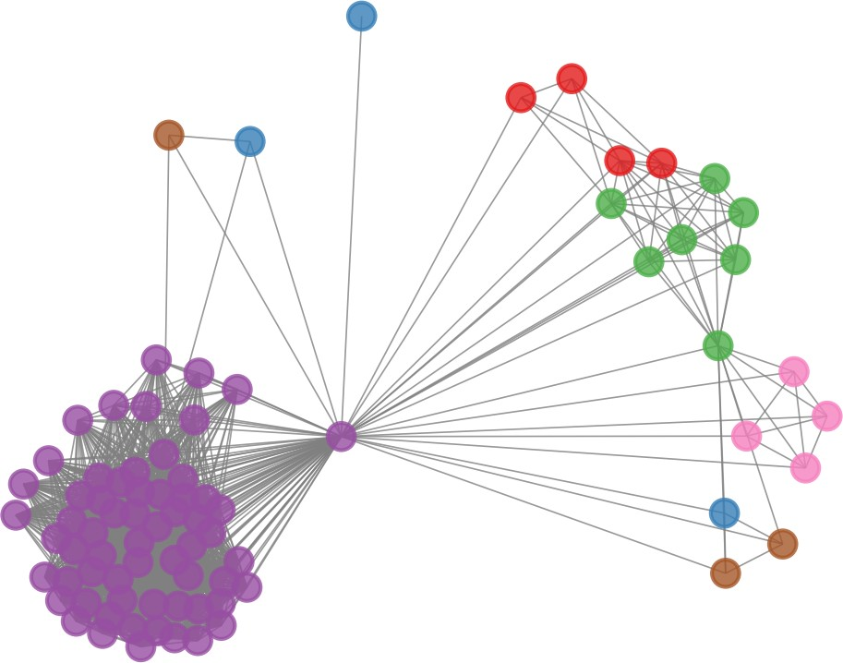


GNN for Graph Classification
Pooling at Layer 1 Pooling at Layer 2
Note
The maximal number of clusters in the following layer (n_{k +1}) is a hyper-parameter of the model (typically 10-25% of n_{k} ).
Image from Ying et al., 2018
Graph Neural Networks

Slide 36
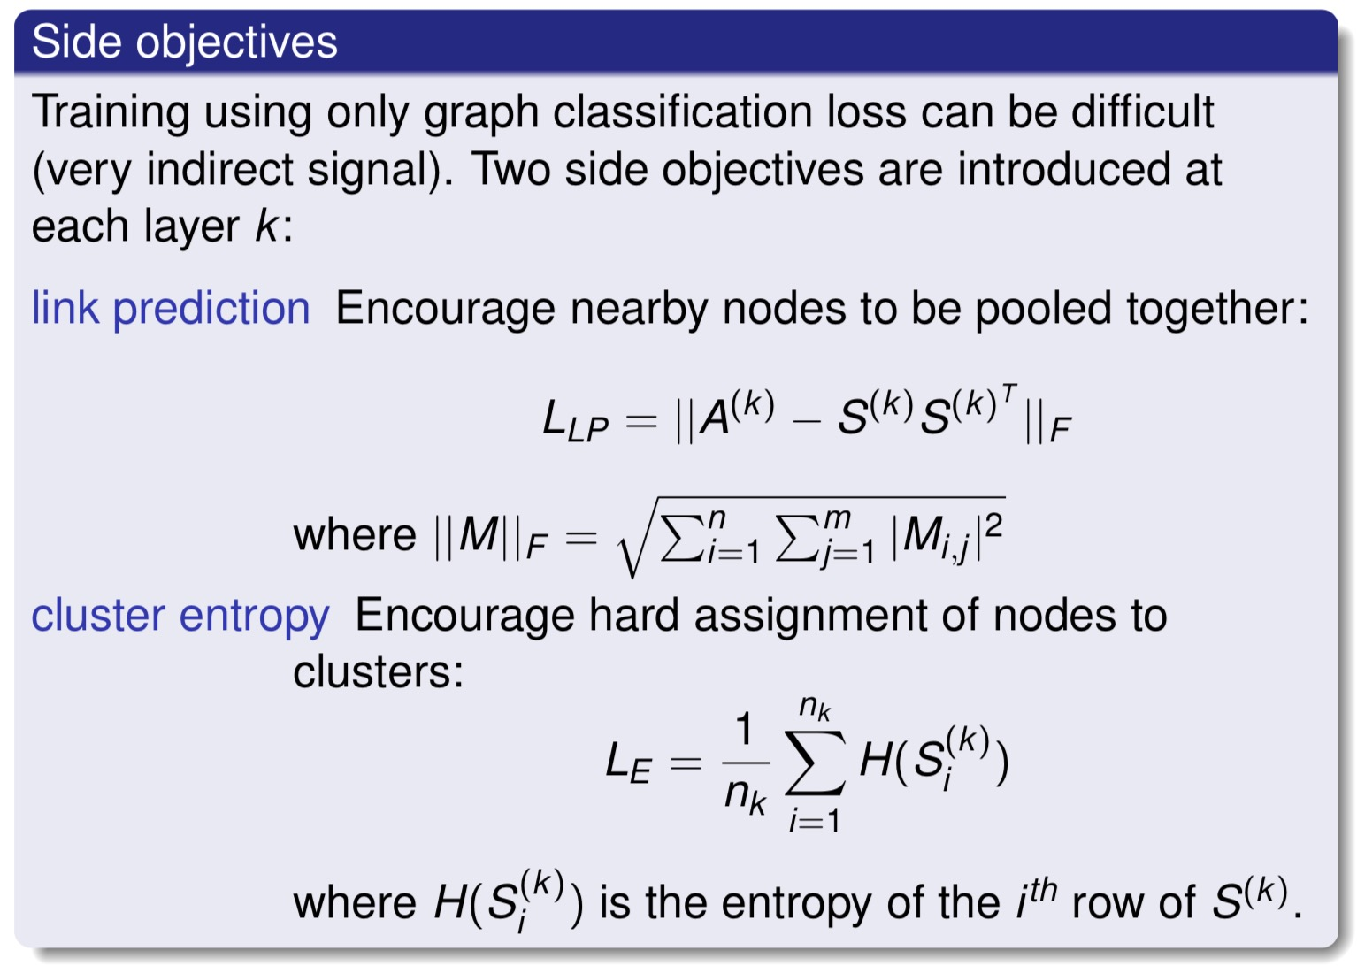
GNN for Graph Classification
Graph Neural Networks

Slide 37
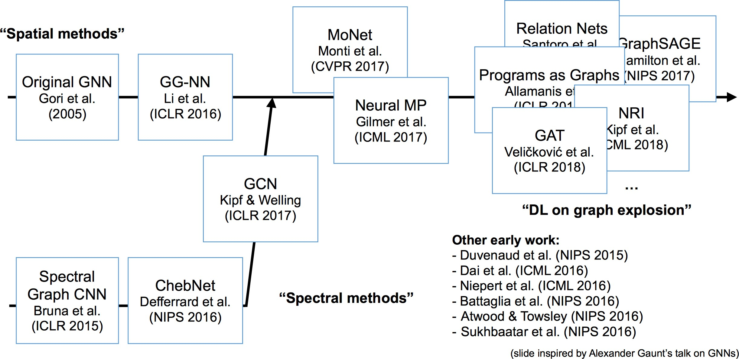
A Brief History of Graph Neural Nets

Slide 38
How do we use GNN / GCN for real problems?

Slide 39
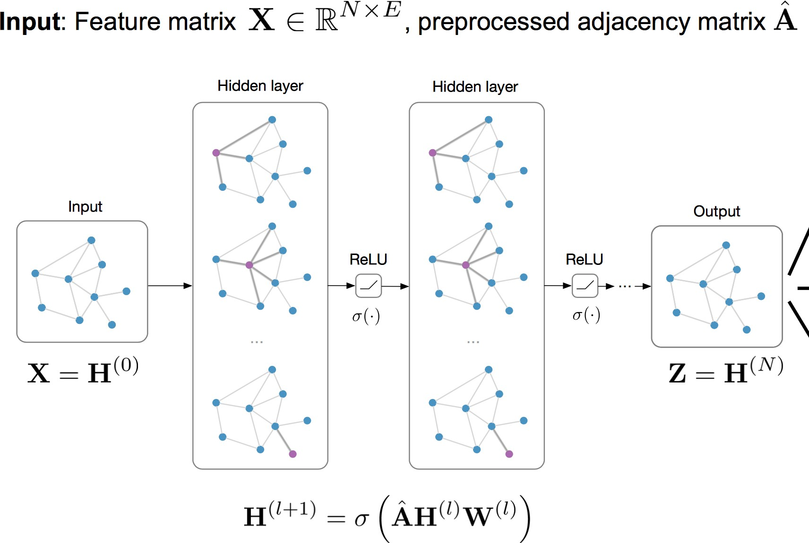
Classification and Link Prediction with GNNs / GCNs

Slide 40
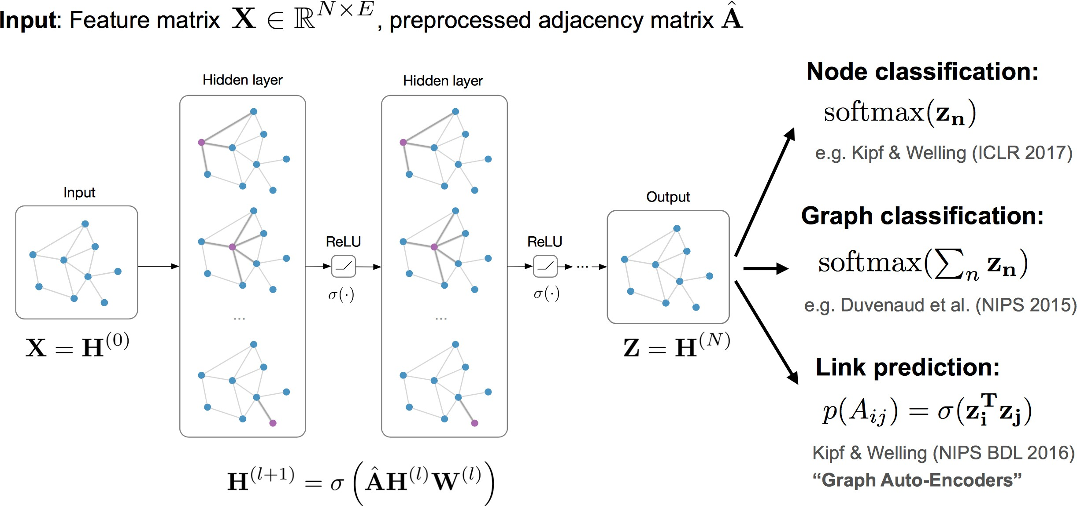
Classification and Link Prediction with GNNs / GCNs

Slide 41
Classification and Link Prediction with GNNs / GCNs

Slide 42
Classification and Link Prediction with GNNs / GCNs

Slide 43
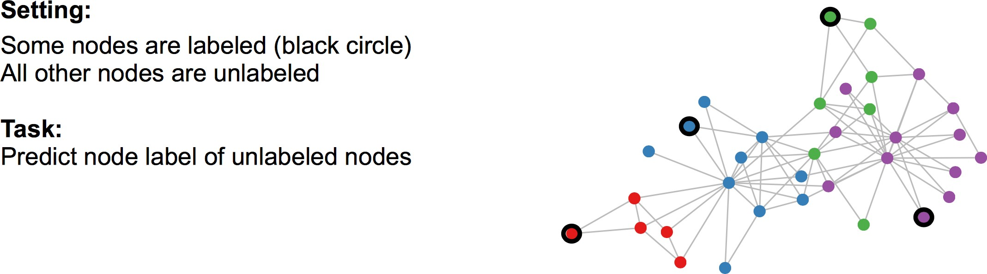
Semi-supervised Classification on Graphs

Slide 44
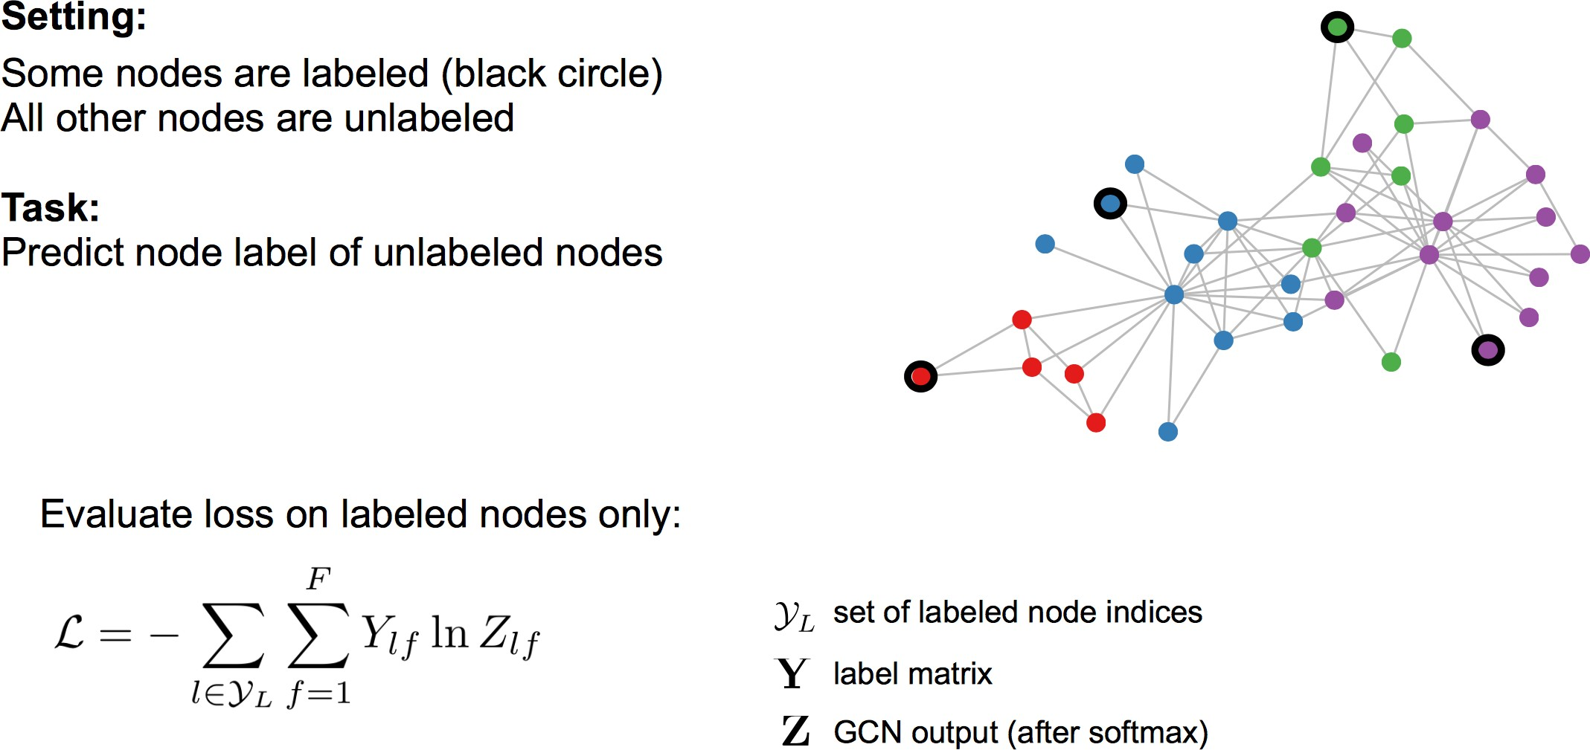
Semi-supervised Classification on Graphs

Slide 45
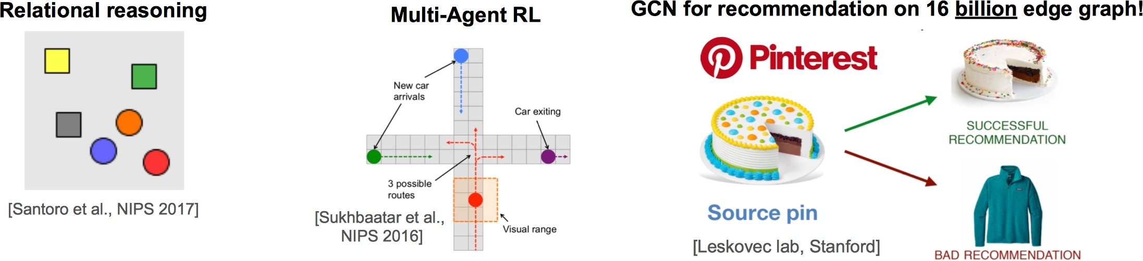
Conclusions
Deep learning on graphs works and is very effective!
Exciting area: lots of new applications and extensions (hard to keep up)
Open problems:
Theory
Scalable, stable generative models
Learning on large, evolving data
— Multi-modal and cross-model learning (e.g., sequence2graph)

Slide 46
Thank you!
Lectured by Shangsong Liang

